Slide 1
Bienvenidos a la presentación de Murder SQL!!
Grupo 1:
.- Miren Alexia García .- Fernando Manzano .- Raúl Soler .- Francisco Jesús Pastor

Slide 2



Slide 3

A crime has taken place and the detective needs your help. The detective gave you the crime scene report, but you somehow lost it. You vaguely remember that the crime was a murder that occurred sometime on Jan.15, 2018 and that it took place in SQL City.

Slide 4
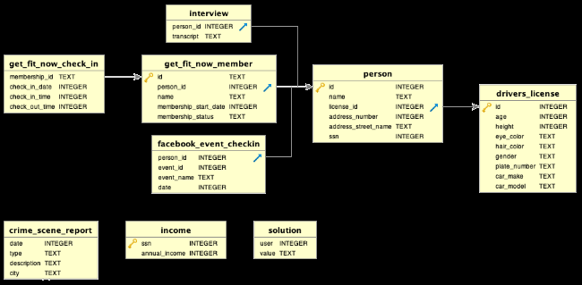

Slide 5

CONEXIÓN A DDBB
connection = sqlite3.connect("./data/sql-murder-mystery.db")
crsr = connection.cursor()
def sql_query(query):
crsr.execute(query)
ans = crsr.fetchall()
names = [description[0] for description in crsr.description]
return pd.DataFrame(ans,columns=names)
pd.set_option('display.max_colwidth', None)

Slide 6
Primera consulta…
query1 = """
SELECT *
FROM crime_scene_report
WHERE type = 'murder'
AND city = 'SQL City'
AND date = 20180115
"""
sql_query(query1)

Slide 7
1.- Testigo 1 vive en la ultima casa de la calle Northwestern Dr.
2.- Testigo 2 se llama Annabel y vive en Franklin Ave.

Slide 9
query2 = """
SELECT name, address_number, address_street_name
FROM person
WHERE address_street_name LIKE '%Northwestern%'
ORDER BY address_number DESC
LIMIT 1
"""
sql_query(query2)
query3 = """
SELECT name, address_number, address_street_name
FROM person
WHERE address_street_name LIKE '%Franklin Ave%'
AND name LIKE '%Annabel%'
"""
sql_query(query3)

Slide 10
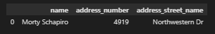
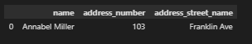

Slide 12
query4 = """
SELECT p.name, i.transcript
FROM interview i
INNER JOIN person p
ON i.person_id = p.id
WHERE p.name = 'Morty Schapiro'
"""
sql_query(query4)
query5 = """
SELECT p.name, i.transcript
FROM interview i
INNER JOIN person p
ON i.person_id = p.id
WHERE p.name = 'Annabel Miller'
"""
sql_query(query1)

Slide 14
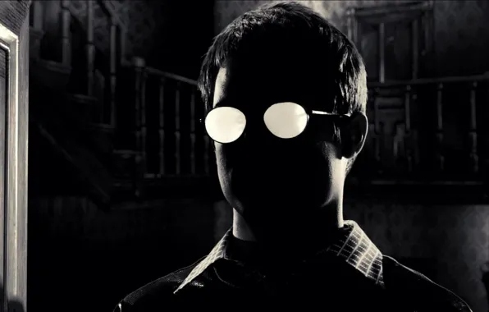
RASGOS DEL SOSPECHOSO ACORDE A LAS ENTREVISTAS
.- miembro get fit now gym
.- miembro oro
.- numero de socio comienza en '48Z%'
.- matricula de coche contiene 'H42W'
.- fue visto entrenando en el gym el 09.01.2018

Slide 16
query6 = """
SELECT a.name, a.id, a.membership_status, b.check_in_date, c.license_id, d.plate_number
FROM get_fit_now_member AS a
LEFT JOIN get_fit_now_check_in AS b ON a.id = b.membership_id
LEFT JOIN person AS c ON a.person_id = c.id
LEFT JOIN drivers_license AS d ON c.license_id = d.id
WHERE a.membership_status = 'gold'
AND a.id LIKE '48Z%'
AND d.plate_number LIKE '%H42W%'
AND b.check_in_date = '20180109'
"""
sql_query(query6)
RASGOS DEL SOSPECHOSO ACORDE A LAS ENTREVISTAS
.- miembro get fit now gym
.- miembro oro
.- numero de socio comienza en '48Z%'
.- matricula de coche contiene 'H42W'
.- fue visto entrenando en el gym el 09.01.2018

Slide 17
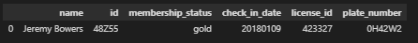
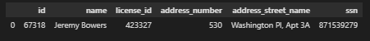
query7 = '''
SELECT *
FROM person
WHERE name = 'Jeremy Bowers'
'''
sql_query(query7)

Slide 18

query8 = '''
SELECT *
FROM interview
WHERE person_id = 67318
'''
sql_query(query8)

Slide 19


Slide 20
PISTAS
.- "lots of money"
.- woman
.- altura entre 5'5" (65") y 5'7 (67")
.- pelirroja
.- conduce un Tesla Model S
.- acudio 3 veces veces el SQL Symphony Concert en diciembre de 2017

Slide 22
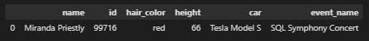
query9 = '''
SELECT b.name, b.id, a.hair_color, a.height, a.car_make || ' ' || a.car_model as car, c.event_name
FROM drivers_license AS a
LEFT JOIN person AS b ON a.id = b.license_id
LEFT JOIN facebook_event_checkin AS c ON b.id = c.person_id
WHERE a.height >= 65 AND a.height <= 67
AND a.hair_color = 'red'
AND a.car_make = 'Tesla'
AND a.car_model = 'Model S'
AND c.event_name = 'SQL Symphony Concert'
GROUP BY c.event_name
HAVING COUNT (c.event_name) = 3
'''
sql_query(query9)
PISTAS
.- "lots of money"
.- woman
.- altura entre 5'5" (65") y 5'7 (67")
.- pelirroja
.- conduce un Tesla Model S
.- acudio 3 veces veces el SQL Symphony Concert en diciembre de 2017

Slide 23

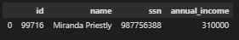
query10 = '''
SELECT person.id, person.name, person.ssn, income.annual_income
FROM person
LEFT JOIN income ON person.ssn = income.ssn
WHERE person.id = 99716
'''
sql_query(query10)

Slide 24

query11 = '''
SELECT *
FROM interview
WHERE person_id = 99716
'''
sql_query(query11)

Slide 26


